Slide 1
Nonrepresentativity in Data
Keith Burghardt and Kristina Lerman
(slides modified from Fred Morstatter)
keithab@isi.edu

Slide 2
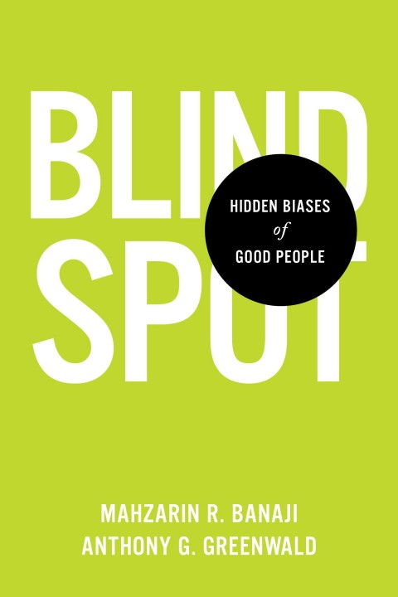
“Hidden Biases of Good People”
Bias is subjective
It’s not easy to point out one’s own bias
Hidden bias can influence our behavior without our noticing its influence
Bias results from our limited knowledge, experience, and information overloading.
If it is inevitable for humans to have bias, can machines help us to be balanced and fair?
Notes:
By “good people” the authors refer to those who intend well and who strive to align their behavior with their intentions.
Implicit Association Test – an effort for finding hidden biases

Slide 3

Can Machines or Algorithms Help?
Information overloading + our laziness our reliance on machines or algorithms
With algorithms, everyone is judged according to the same rules
In theory, bias should be eliminated
In reality, algorithms reinforce discrimination
Ample examples are given in WMD and in “The Filter Bubble”
Reasons include: opacity, lack of regulations, and data bias
Notes:
Can machines or algorithms help eliminate bias?
Opacity is about we don’t have access to the “same” rules or data used
Book “Cyberphobia” elaborates the concept of lack of regulations
- https://www.scientificamerican.com/article/pogue-what-facebook-is-doing-to-combat-fake-news/?WT.mc_id=SA_printmag_2017-02

Slide 4
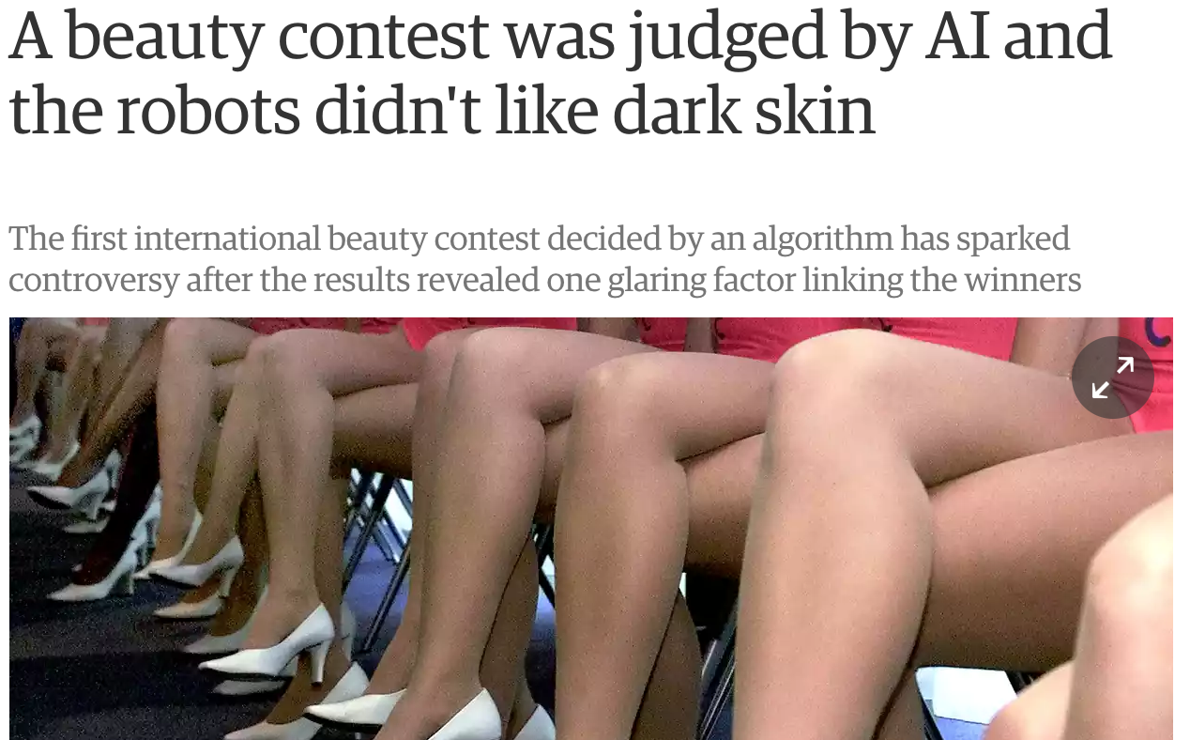

Data Bias – An Example
Biases innately exist in data
“...the main problem was that the data the project used to establish standards of attractiveness did not include enough minorities...”
Notes:
Add Xintao Wu’s stuff?

Slide 5
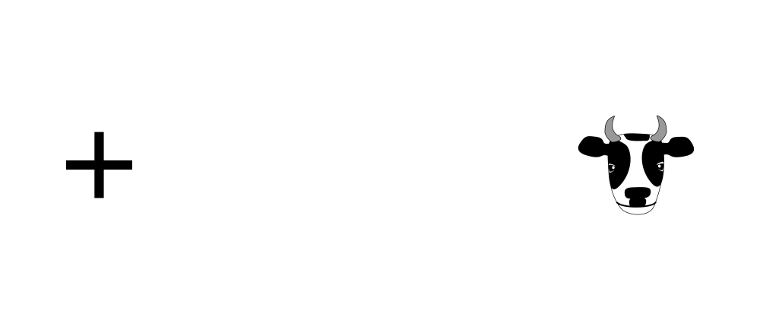
If We Can Detect Bias, We Can Mitigate It
Visual bias example
We should look more, around and beyond
“Orchestrating Impartiality”
“<5% all players in top 5 symphony orchestras are female musicians in 1970, …
but 25% today”
The impact of “blind” auditions on female musicians
In this lecture, we look at one kind of bias - social data bias
Notes:
Bias is often hidden, and exists without notice
Orchestrating impartiality: The impact of “blind” auditions on female musicians
Up to now, we established that there exist biases; they are not easy to detect; if we can detect it, we can probably mitigate it

Slide 6

Bias Definition(s)
Bias Definition:
Prejudice in favor of or against one thing, person, or group compared with another, usually in a way considered to be unfair.
Operational Definition:
Non-representativity
OR
Representative
Sample
Non-Representative
Sample

Slide 7
Social Data Bias
Population Biases
When the users under study to not match the population.
Behavioral Biases
The features of the site dictate how it is used.
Content Biases
Contextual behavioral bias. Example: Parents talk differently to their children than they do to other users.
Linking Biases
Network can influence behavior. Example: users behave differently as their follower count increases on Twitter
Temporal Variations
User behavior changes with time.
Redundancy
Same content being posted multiple times.
Olteanu, Alexandra, et al. "Social Data: Biases, Methodological Pitfalls, and Ethical Boundaries." (2019).
Notes:
An impressive list of biases, but it may not be exhaustive. The authors pointed out biases, pitfalls and boundaries. This tutorial tries to show that we actually can do something about it.

Slide 8
Before Social Data
Smaller Samples
WEIRD
Western, educated, industrialized, rich and democratic
“Laboratory” setting
Non-scalable content analysis
…

Slide 9
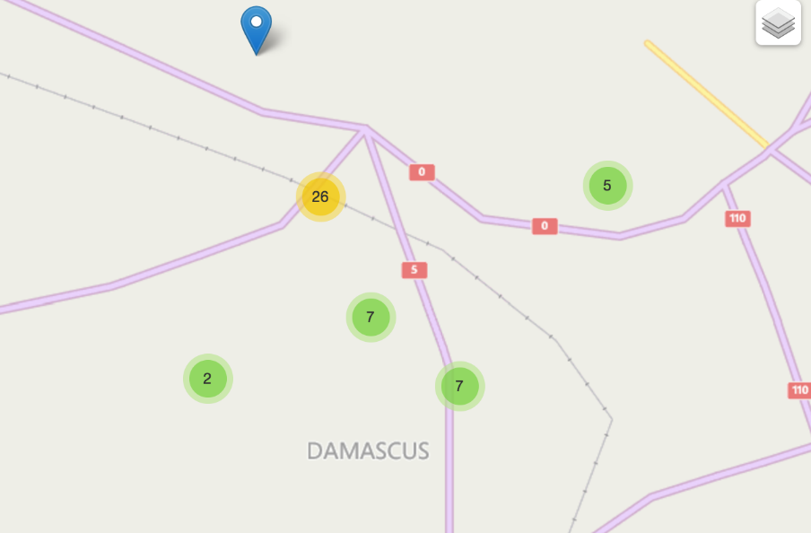

Social Media
Geolocated tweets:
Damascus, Syria
Who are the most important people?
How does information flow through the city?
Top Hashtags:

Slide 10
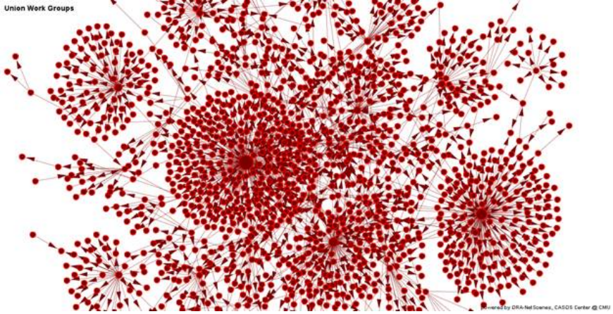
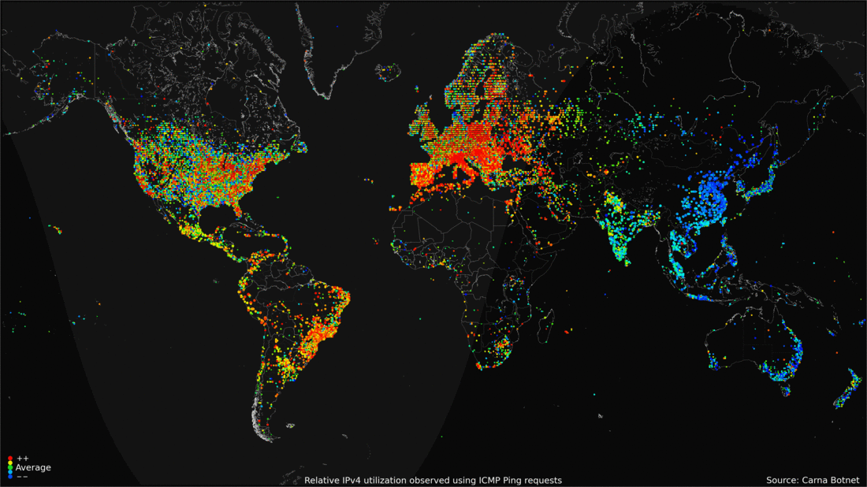
Social Media Mining
2.34 billion social media users in 2016.
Enables us to answer societal questions at a global scale.
Source: https://blog.kaspersky.com/amazing-internet-maps/10441/
Notes:
https://www.statista.com/statistics/278414/number-of-worldwide-social-network-users

Slide 11
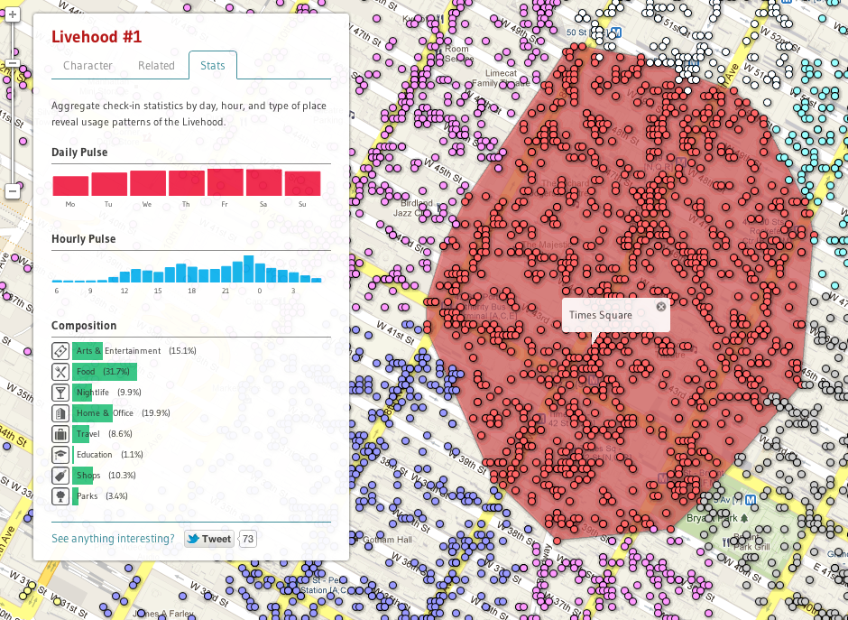
What are those questions?
Information Diffusion – Who will buy a product?
Who will be infected by a disease?
What are the dynamics of an urban area?
What biases exist in society?
Learn from social data to learn about society!

Slide 12



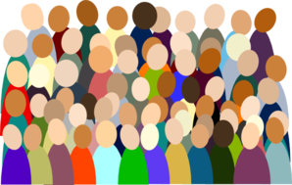

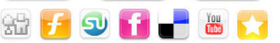
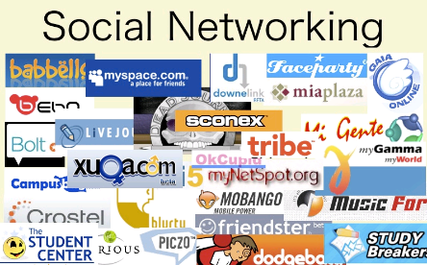

Social Media Mining
When we study social media data, we want to study society. We only get traces of human behavior.

Slide 13

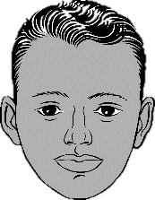
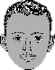
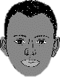
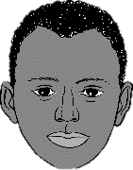
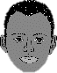
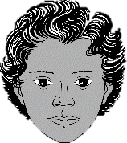

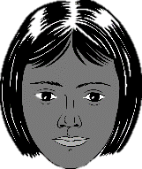

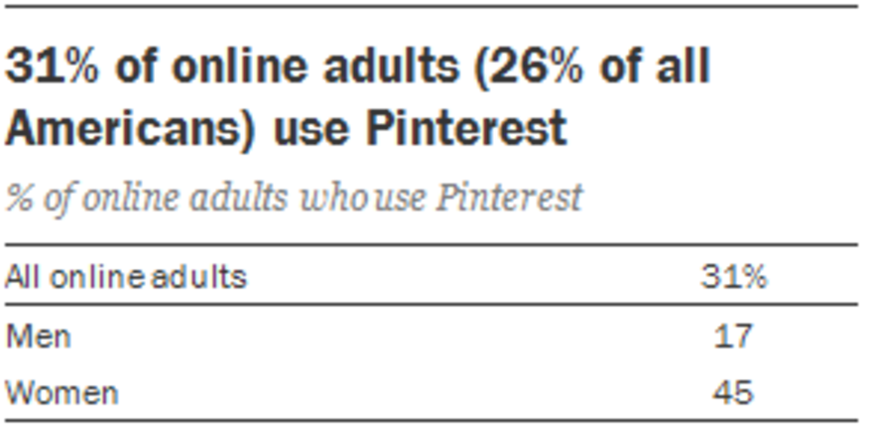
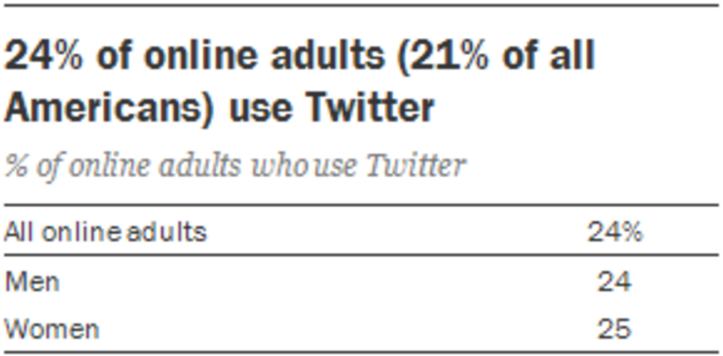
Driving Challenge: Representativity
The World
Social Media
Sampled Social Data
1
2
Notes:
Social media sites don’t share their data, so collecting samples is necessary.

Slide 14
Goals of [SM] Analysis
Type I: To understand phenomena specific to social software systems.
Type II: To understand and influence phenomena beyond social platforms.

Slide 15
Threats to Validity of SM Analysis
Construct Validity: Are you measuring what you think you are measuring?
Internal Validity: Does your analysis lead from the measurements to your conclusions?
External Validity: To what extent findings generalize?
Ecological validity: Does your experimental setup reflect the reality you are trying to study?
Temporal validity: Things change with time. Does this invalidate the conclusions?
Notes:
Hypothesis: Self-esteem increases with age
Construct validity: Are the proxies used to measure self-esteem actually measuring self-esteem?
Internal validity: Are conclusions valid if data cleaning removes textual cues reflecting confidence?
External validity: Are findings from a given platform generalizable beyond it?

Slide 16
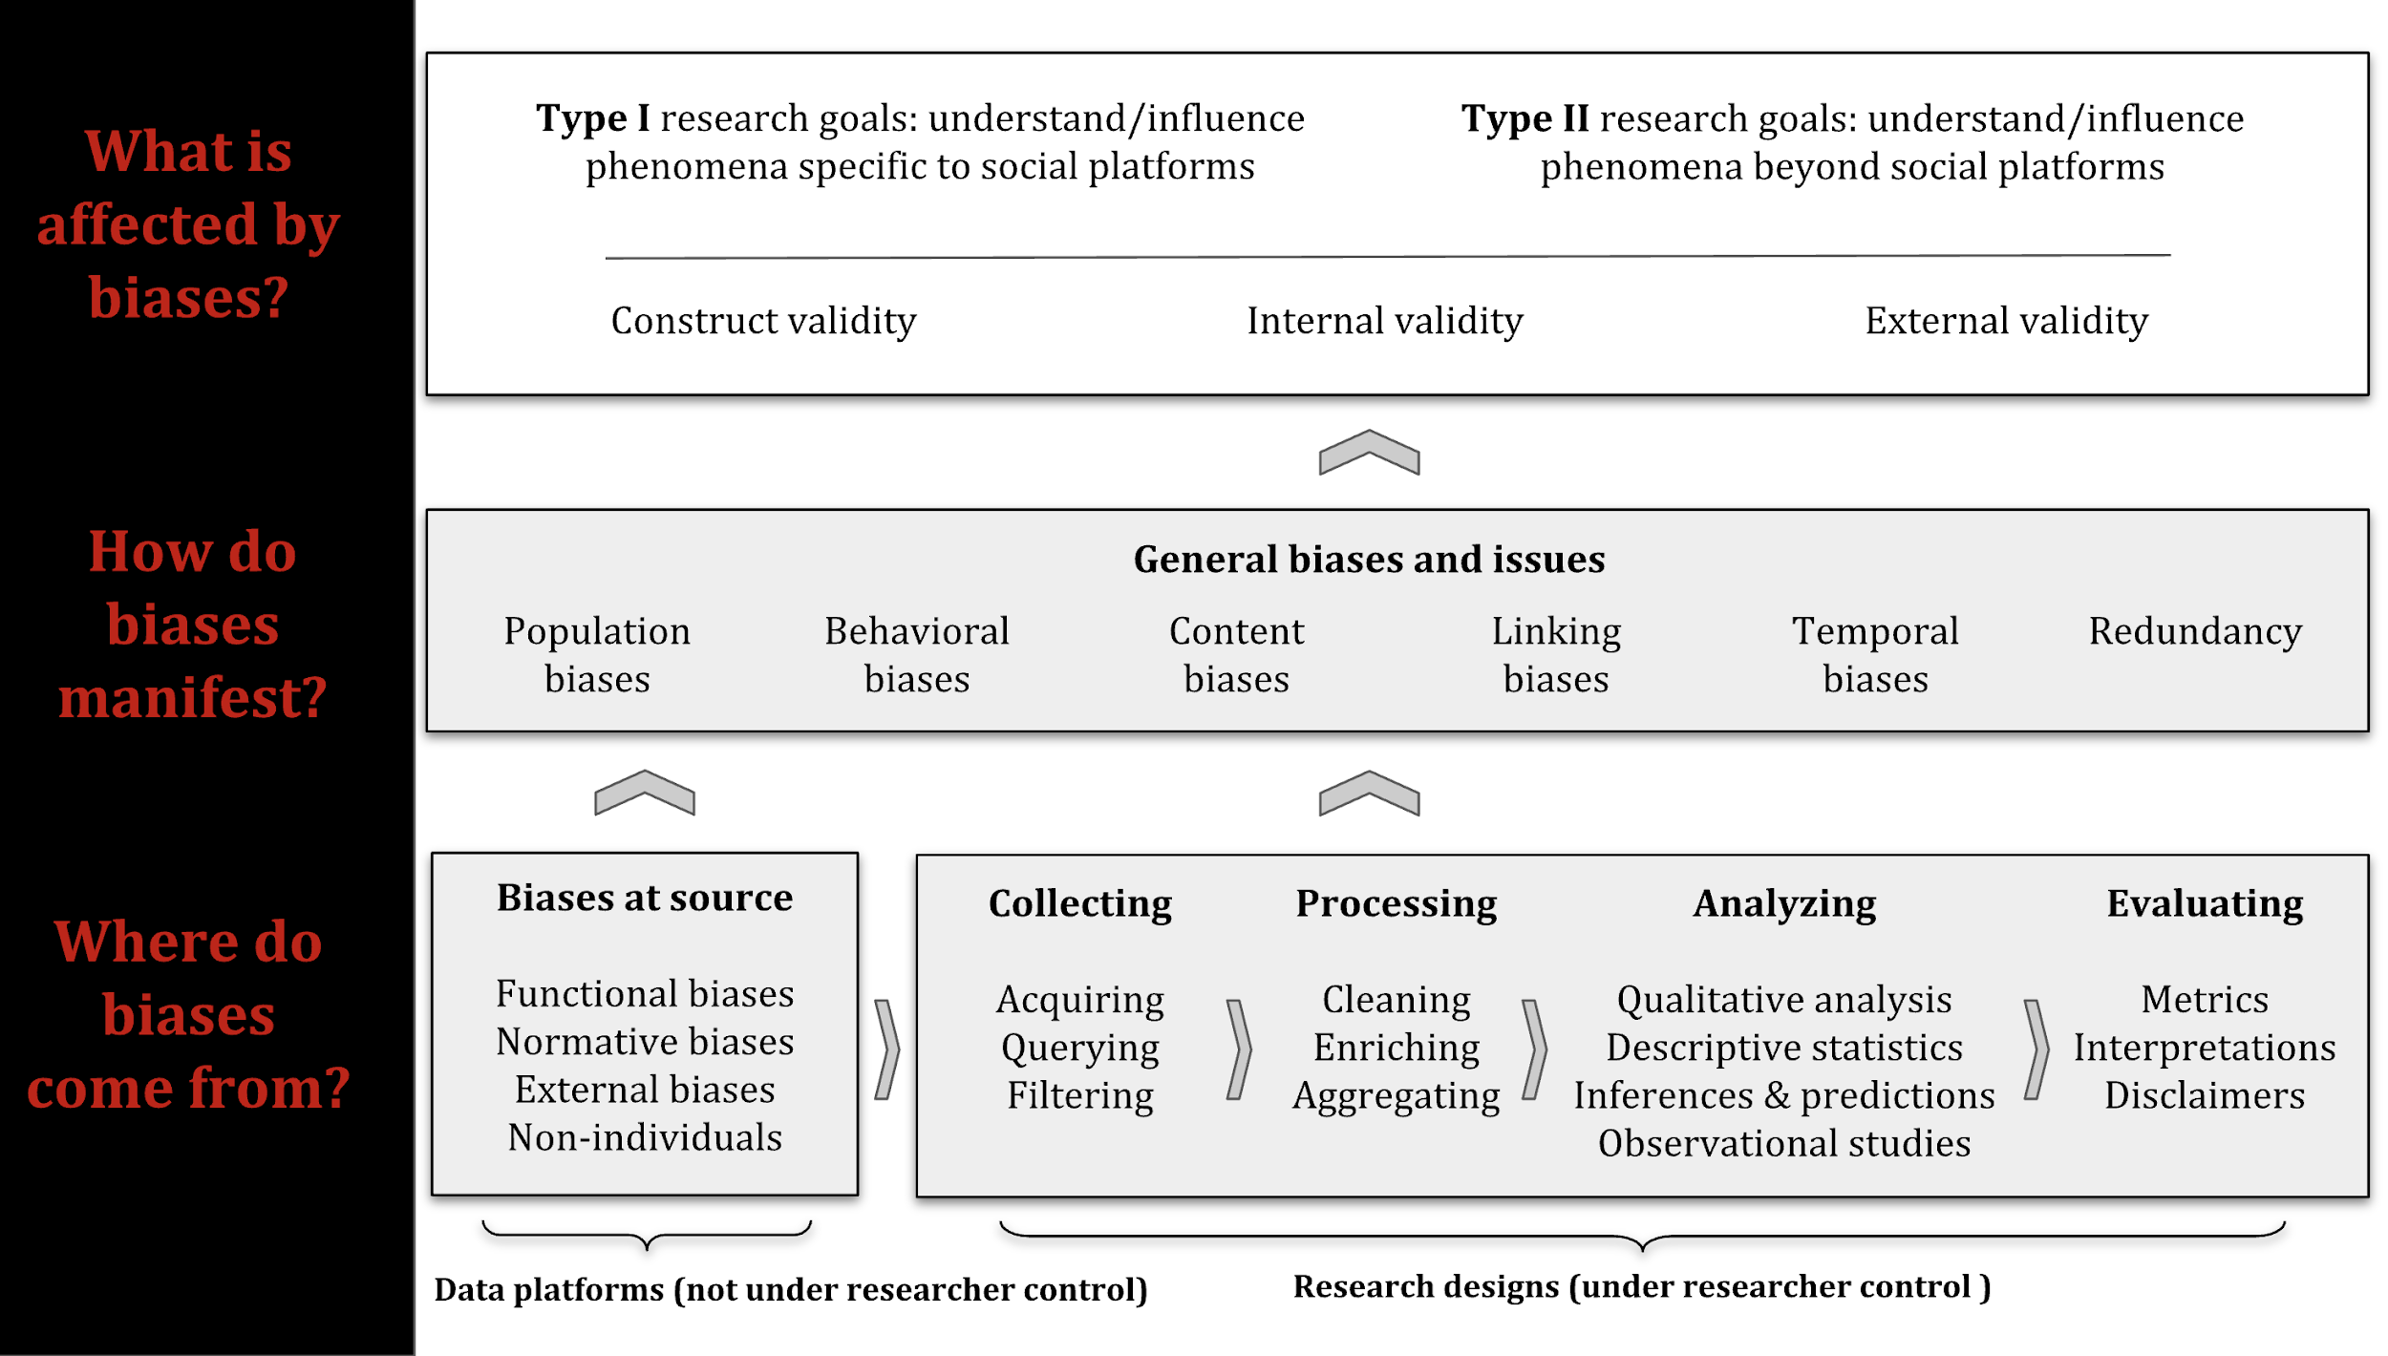
Bias Taxonomy

Slide 17
How do biases manifest?
Population Biases
Behavioral Biases
Content Production Biases
Linking Biases
Temporal Biases
Redundancy Biases

Slide 18
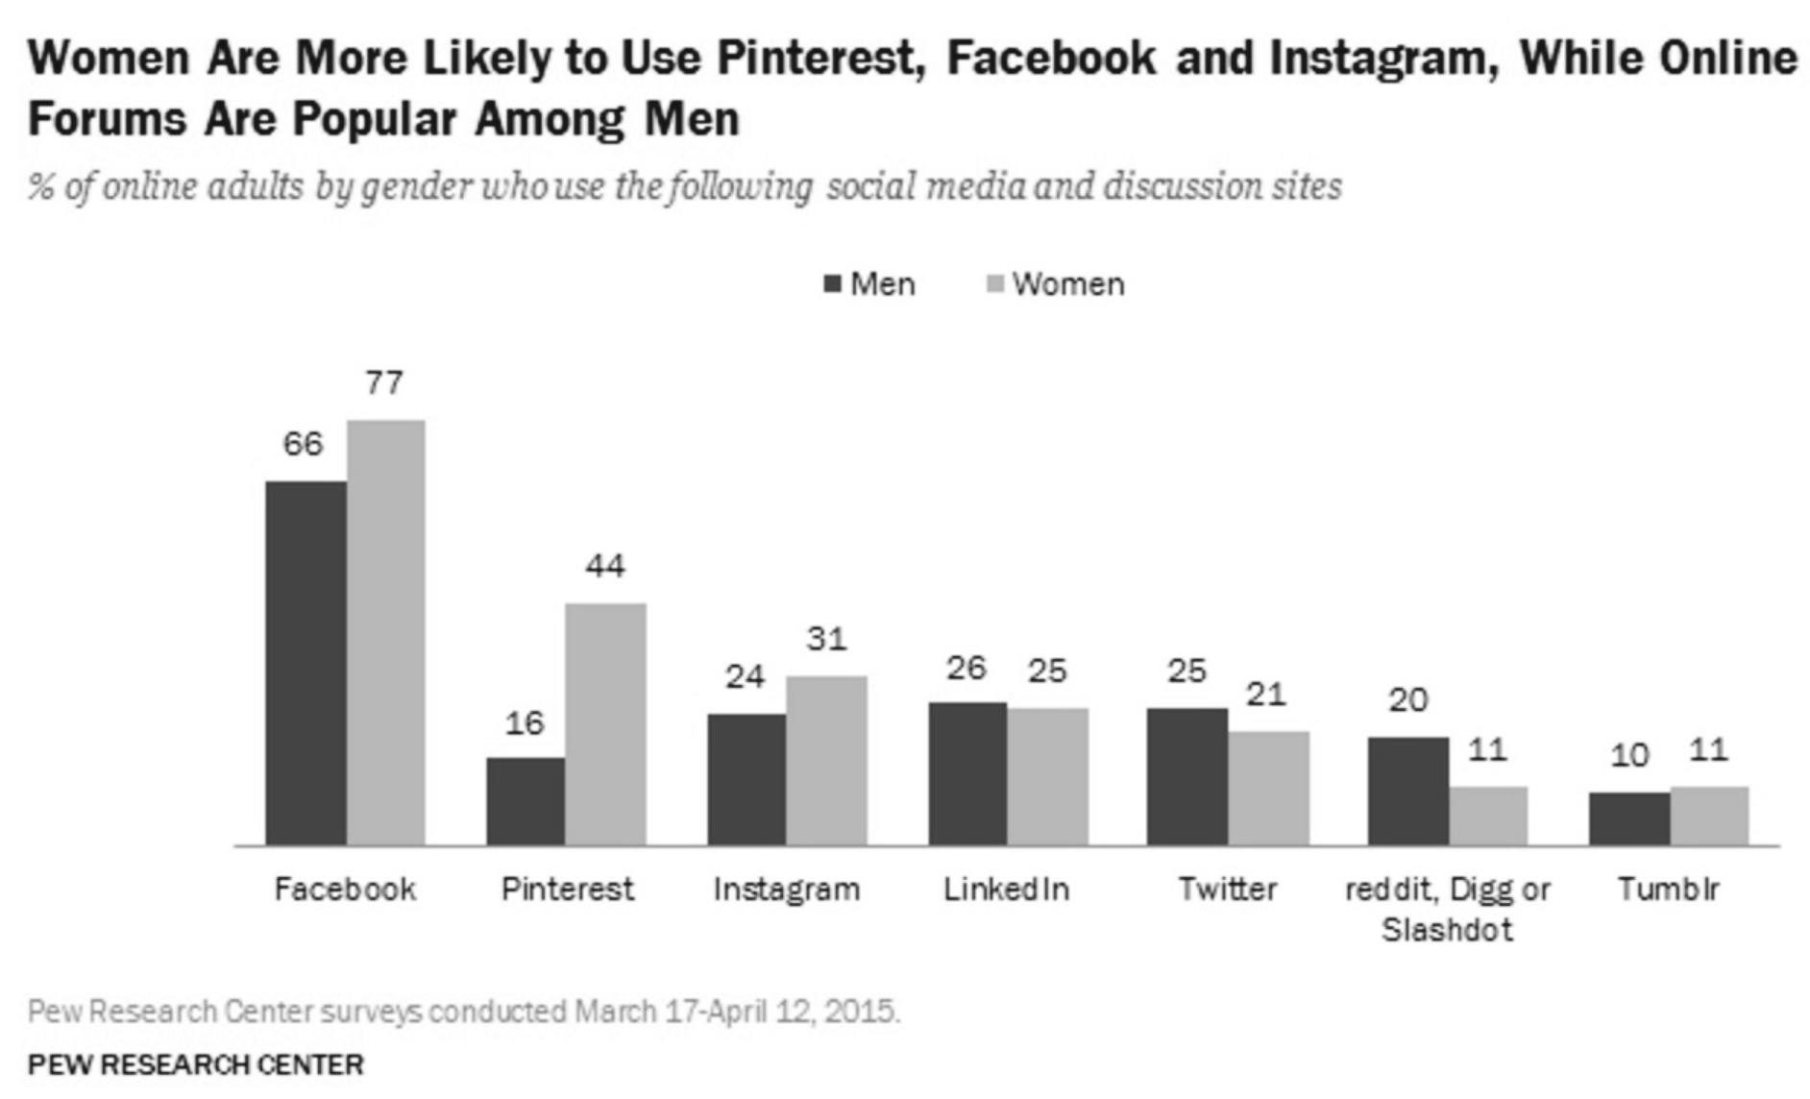
Population Biases
Demographic information of sample does not match target population.

Slide 19
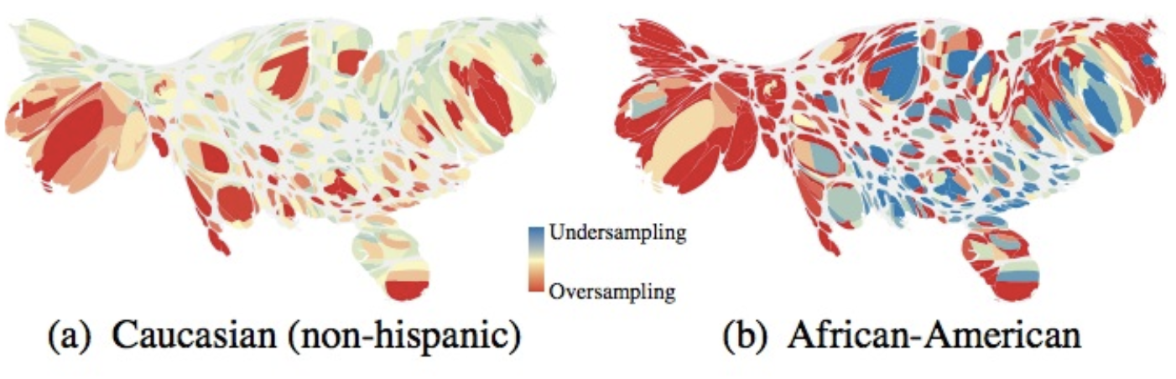
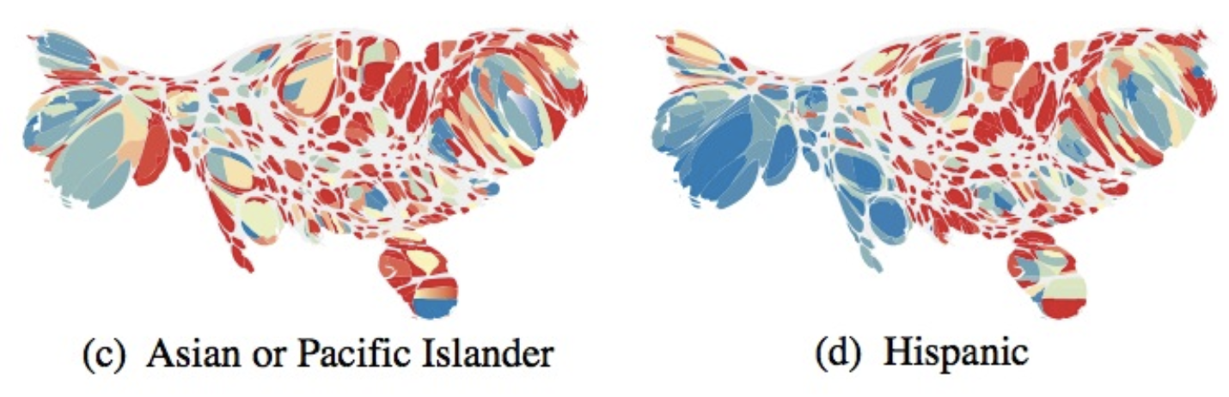
Demographics Attracted to Twitter
Mislove et al. 2012
Notes:
Twitter

Slide 20
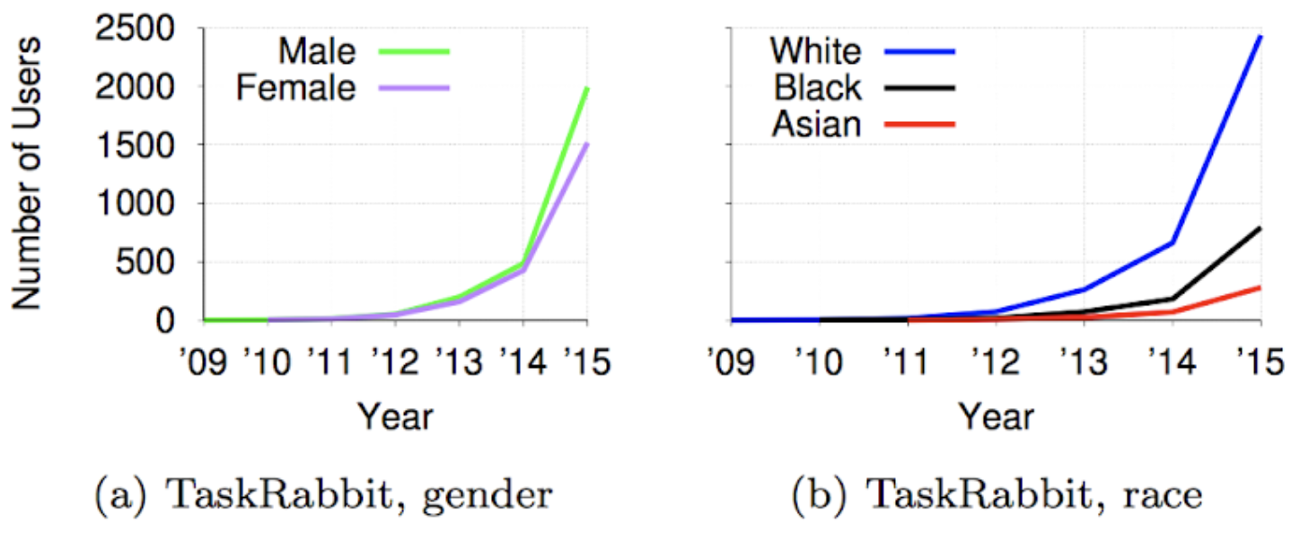
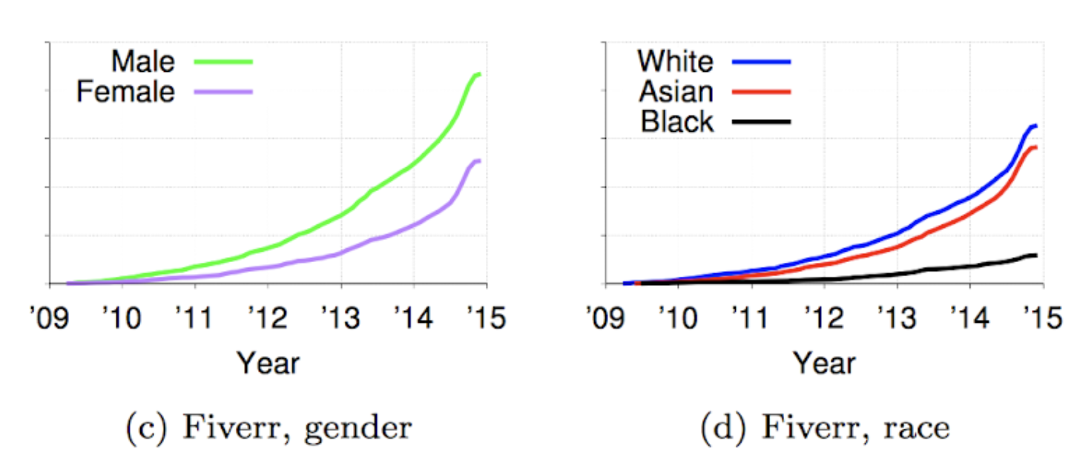
Different Demographics, Different Growth Rates
Hannák, Anikó, et al. "Bias in online freelance marketplaces: Evidence from taskrabbit and fiverr." Proceedings of the 2017 ACM conference on computer supported cooperative work and social computing. 2017.

Slide 21
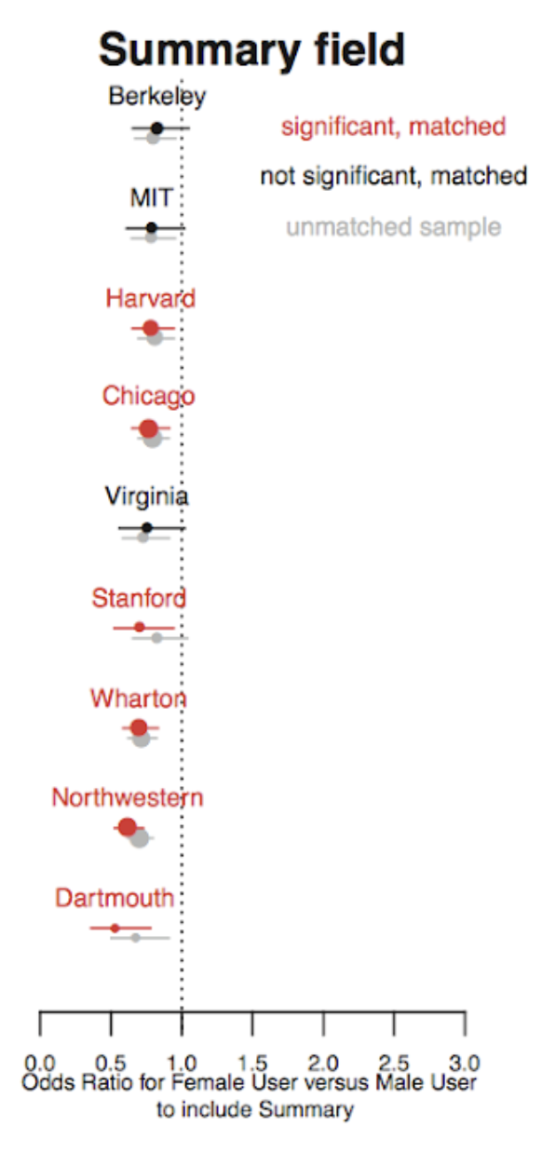
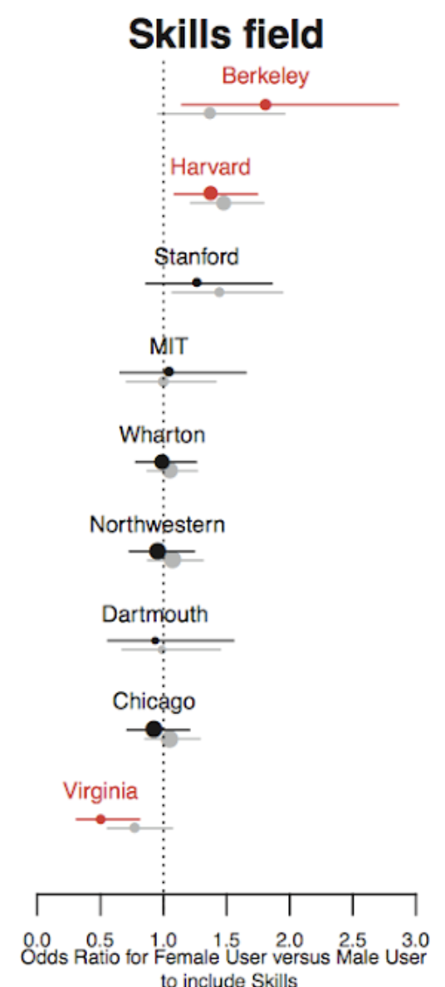
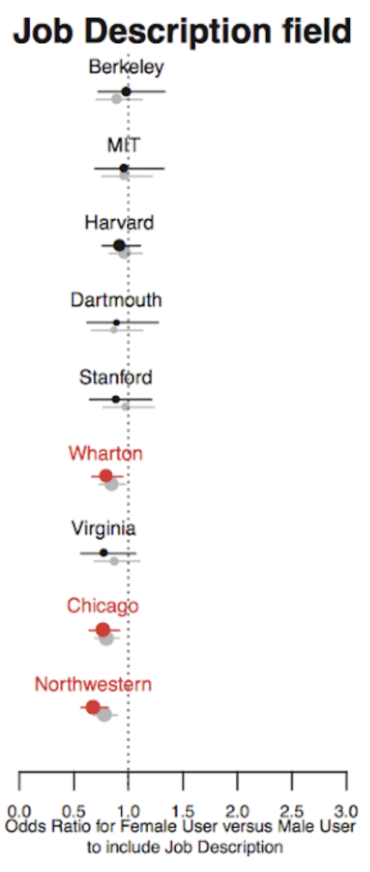
Different Demographics, Different Users
Altenburger, Kristen, et al. "Are there gender differences in professional self-promotion? an empirical case study of linkedin profiles among recent mba graduates." Proceedings of the International AAAI Conference on Web and Social Media. Vol. 11. No. 1. 2017.
Notes:
Propensity score matching
For most universities that females and males are equally likely to include more structured data fields such as Honors and Skills, and for some universities females are more likely to include at least one Skill.

Slide 22
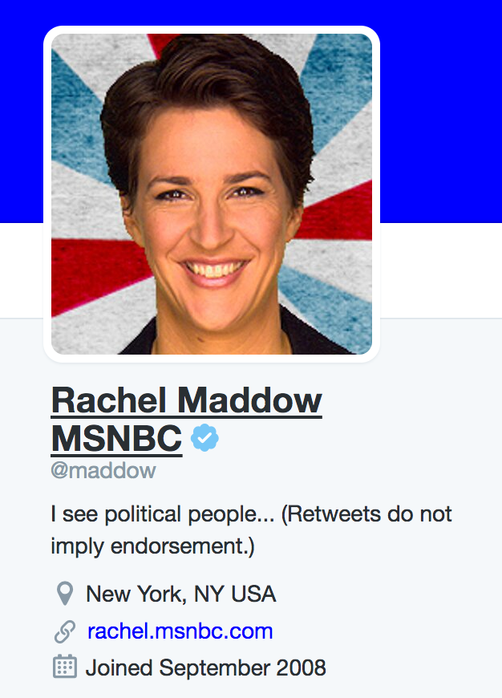
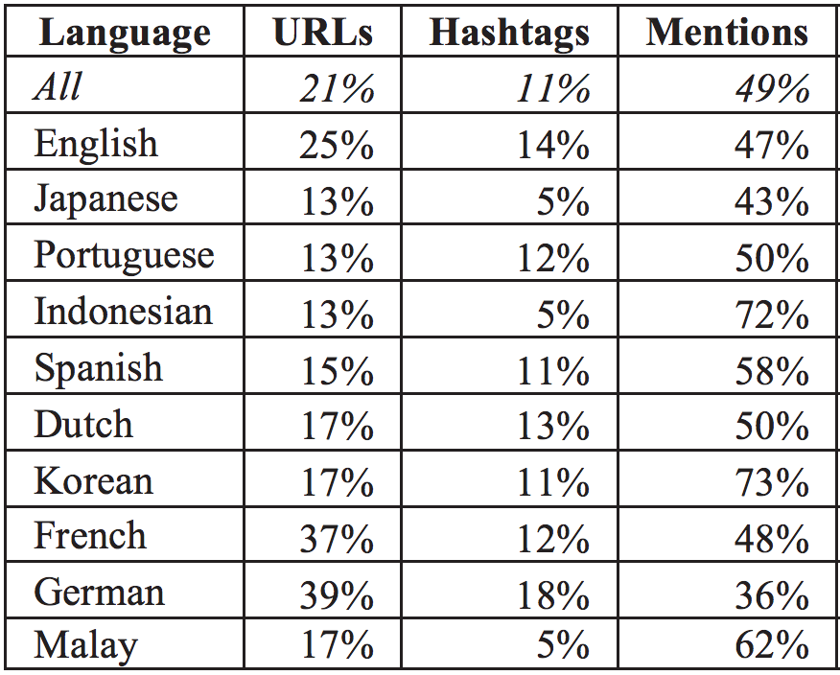
User Base Discrepancies
The user base is not a monolith.
Different communities use the same features differently.
Awareness is key to effectively interpret social media.
Hong, Lichan, Gregorio Convertino, and Ed H. Chi. "Language Matters In Twitter: A Large Scale Study." ICWSM (2011).

Slide 23
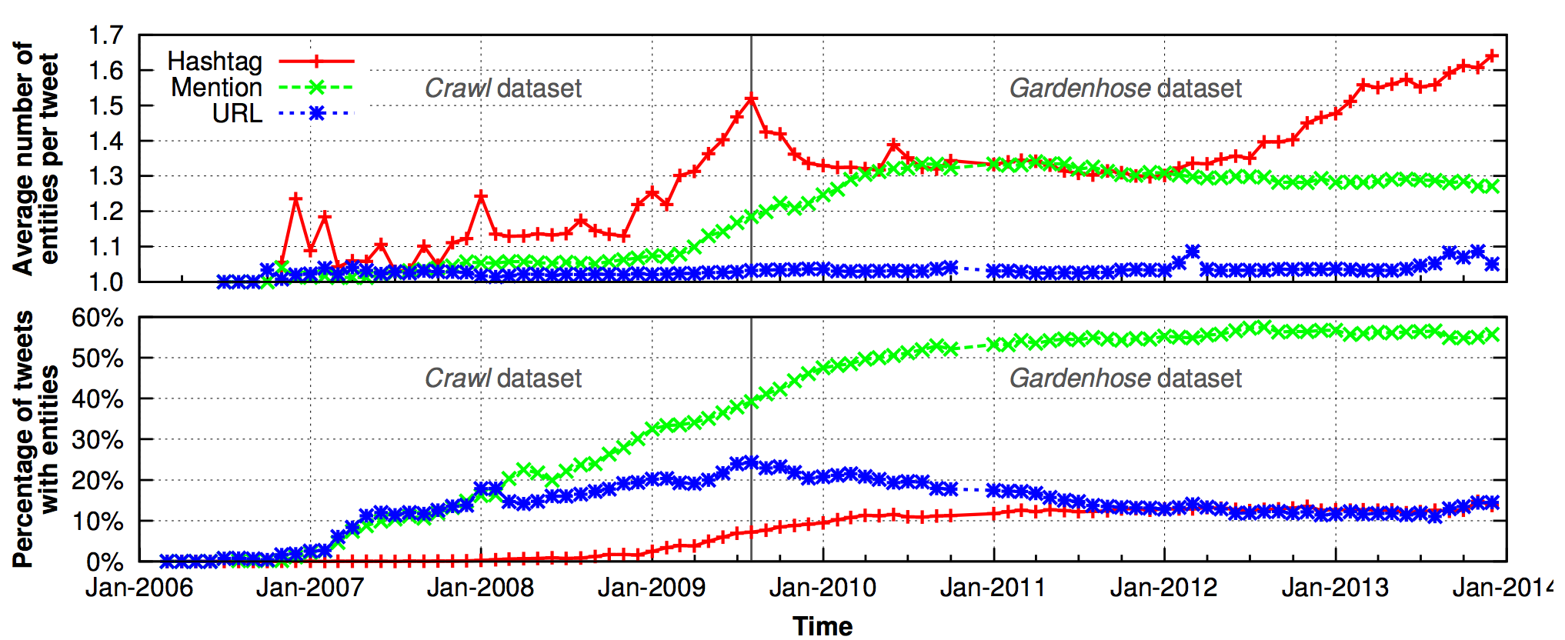
User Base Evolution
As a site gains popularity, its user base changes.
This can also change the way a site is used.
Liu, Yabing, Chloe Kliman-Silver, and Alan Mislove. "The Tweets They Are a-Changin: Evolution of Twitter Users and Behavior." ICWSM. Vol. 30. 2014. 5-314.

Slide 24
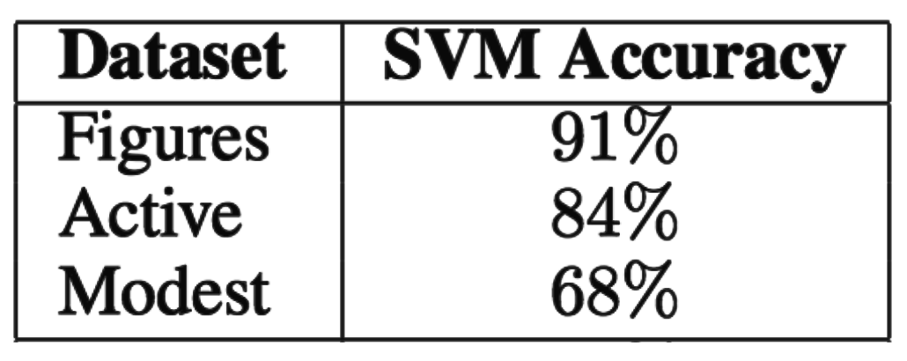
How well do proxies fare?
Relation between proxy populations (e.g., users with location set to Los Angeles), and a target population (users in Los Angeles) is unknown [Ruths and Pfeffer 2014].
Classification tailored to highly-connected folks:
Existing methods fail on “ordinary” users.

Slide 25
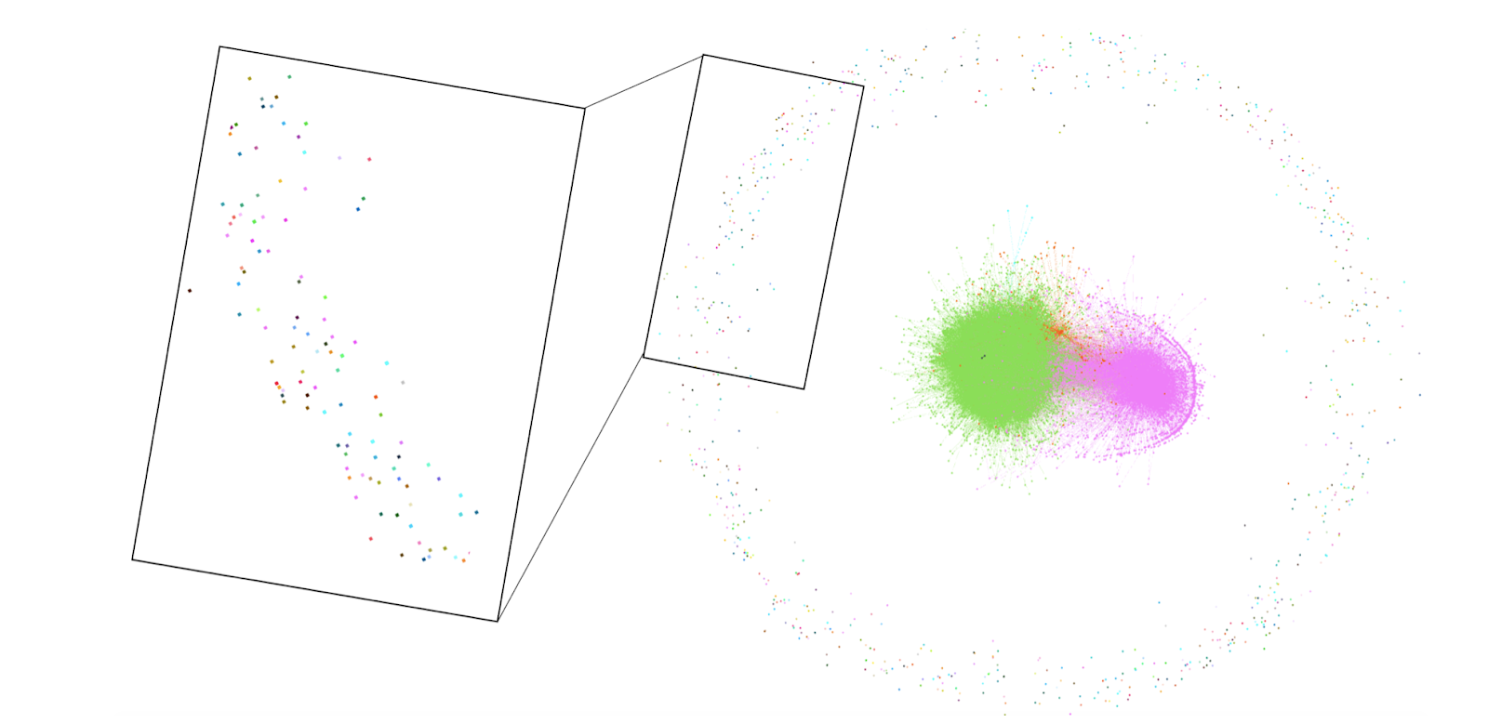
Exclusion Bias

Slide 26
Behavioral Biases
Differences in user behavior
Across platforms
Across contexts
Across datasets

Slide 27
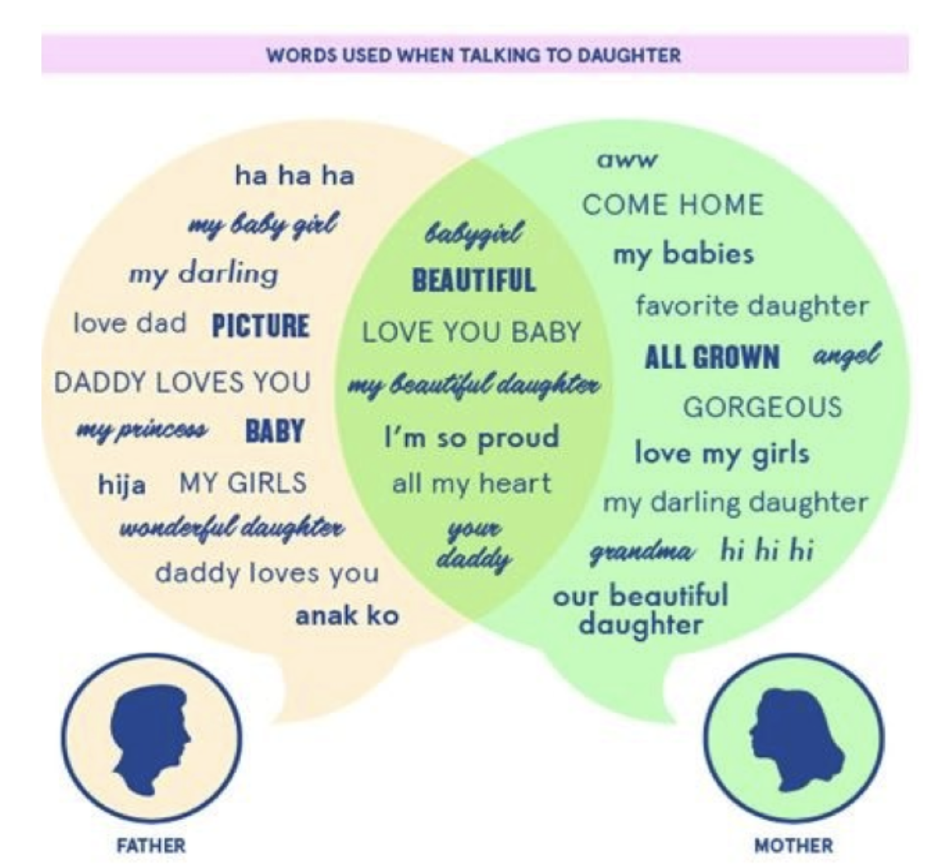
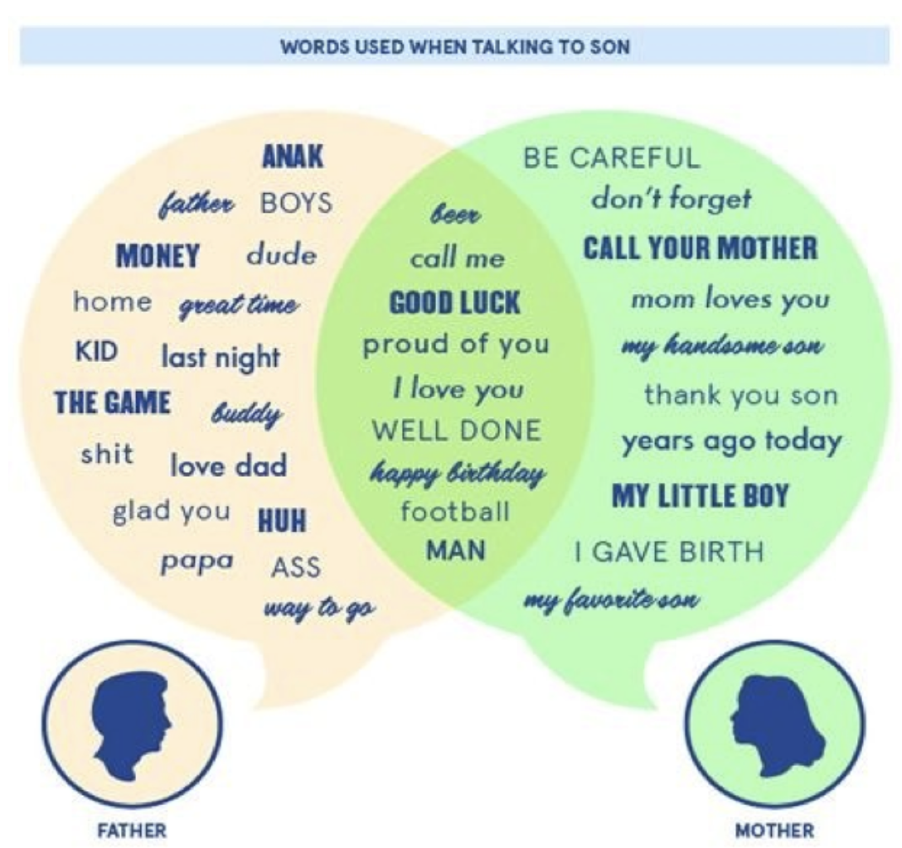
Interaction Biases
How users interact with each other.
[Burke ICWSM 2013]
Notes:
You are a witness to this.

Slide 28
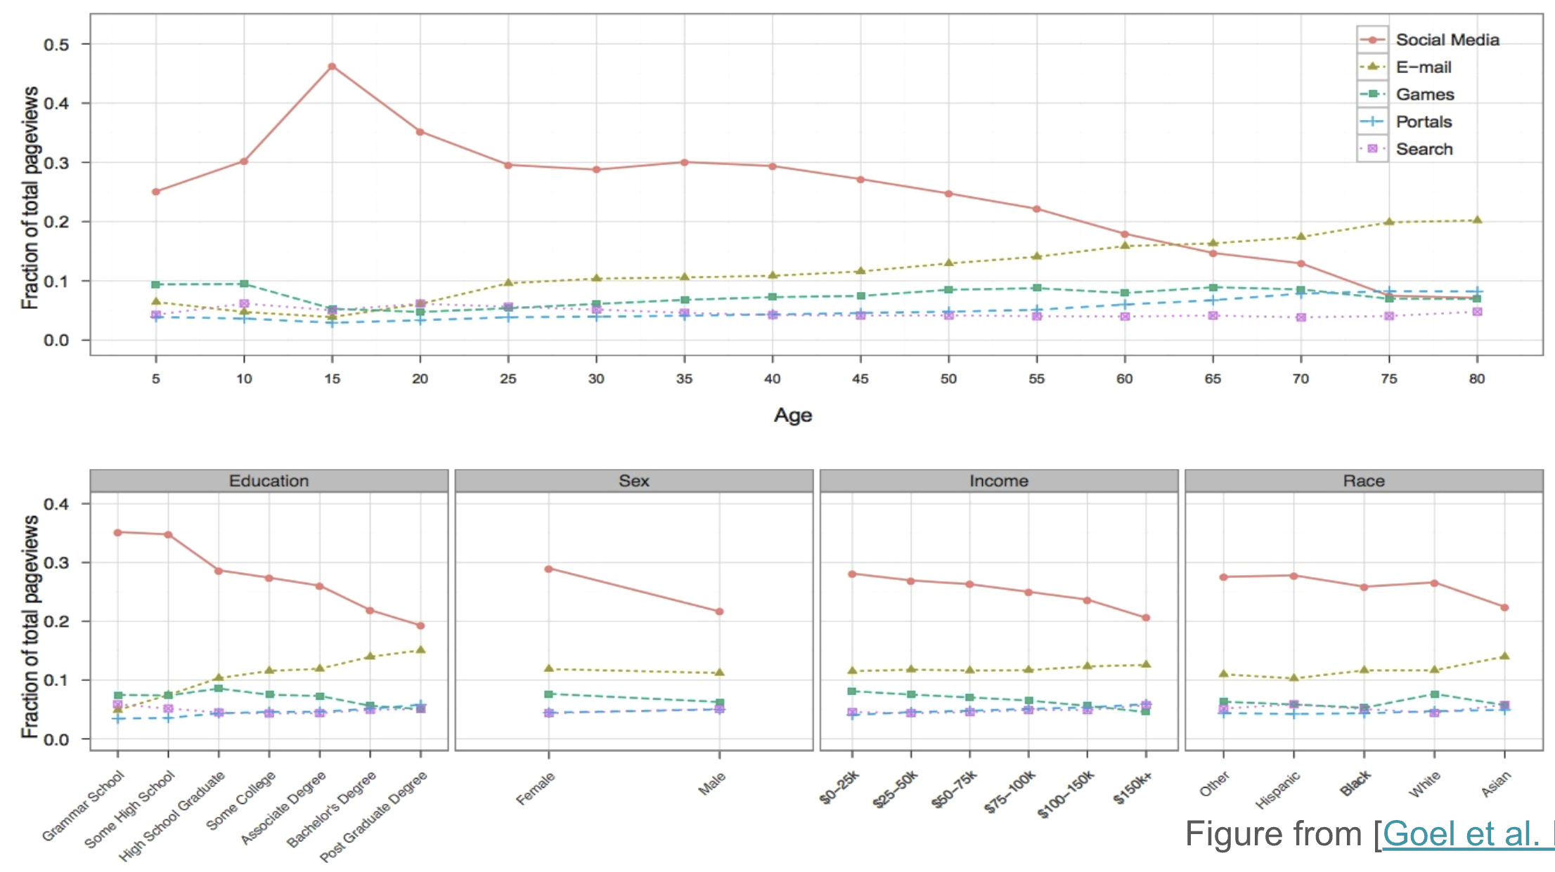
Content Consumption Biases
Different demographics use social media, email, etc. at different frequencies

Slide 29
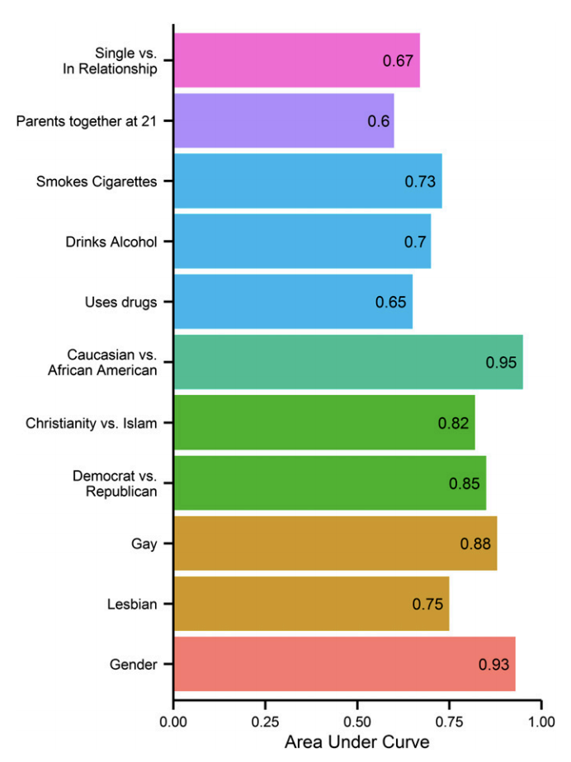
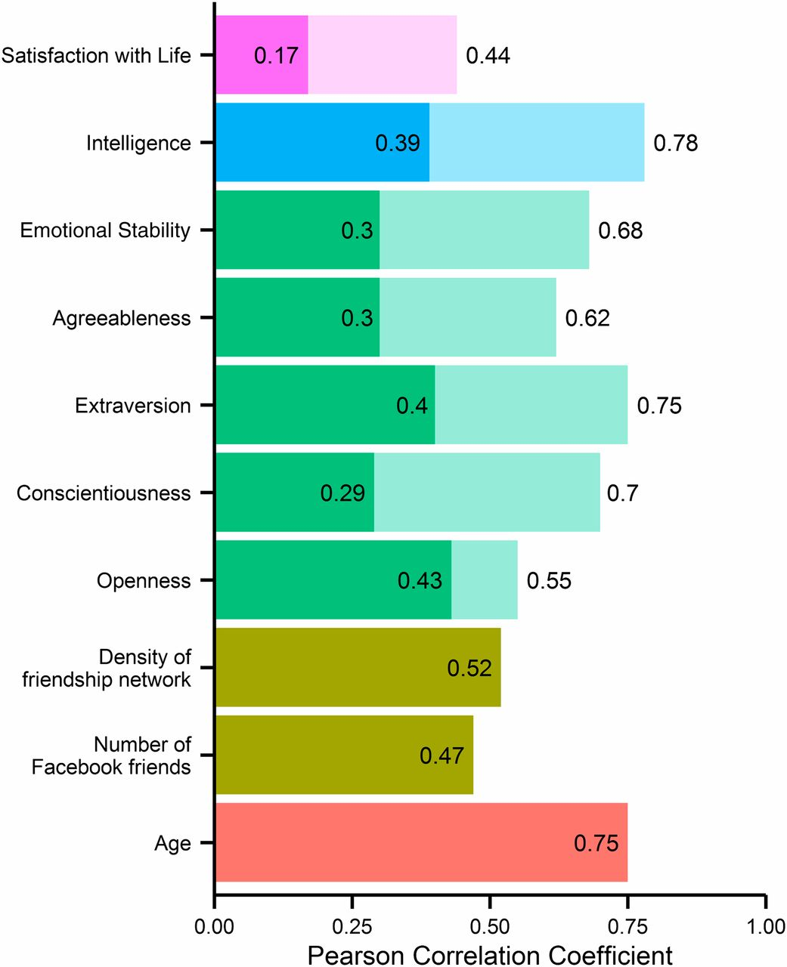
Consumption Biases
Consumption can predict demographics
[Kosinski, PNAS 2013]
Notes:
Likes can predict these attributes (all dichotomous)
Prediction accuracy of regression for numeric attributes and traits expressed by the Pearson correlation coefficient between predicted and actual attribute values; all correlations are significant at the P < 0.001 level. The transparent bars indicate the questionnaire’s baseline accuracy, expressed in terms of test–retest reliability.

Slide 30
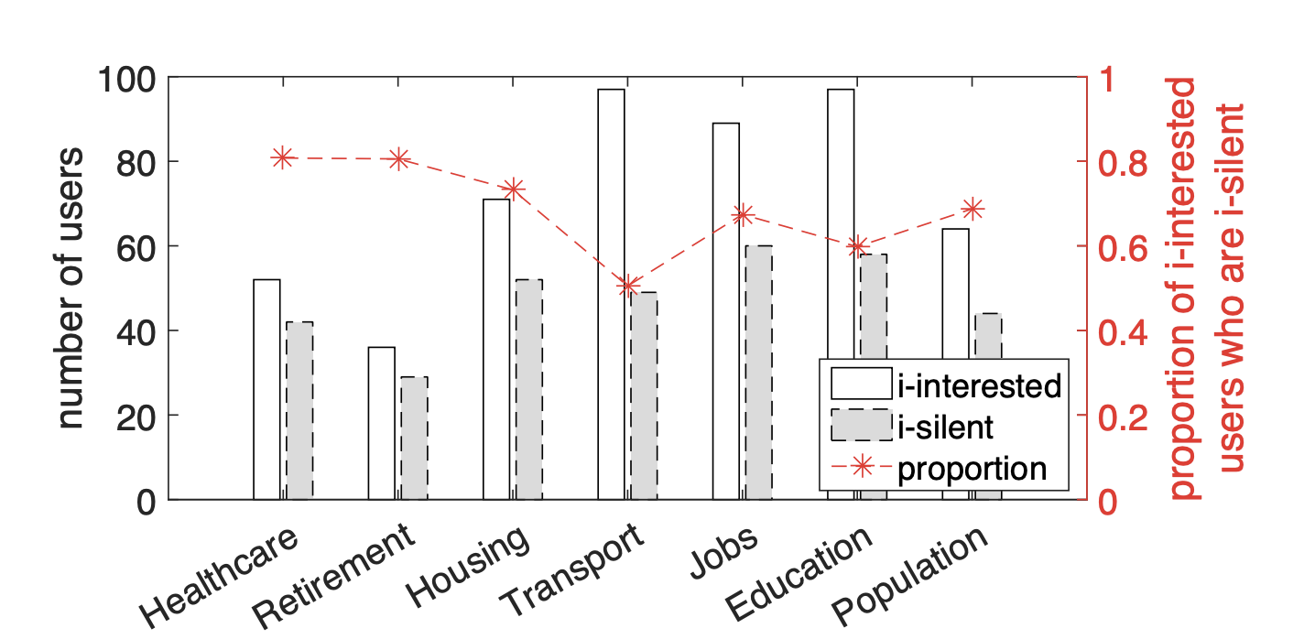
Misreports and Self-Selection
Many interested parties choose to stay silent. i-silent: issue-specific silent users
Gong et al., 2016
Notes:
Talk about social sensing, sampling

Slide 31
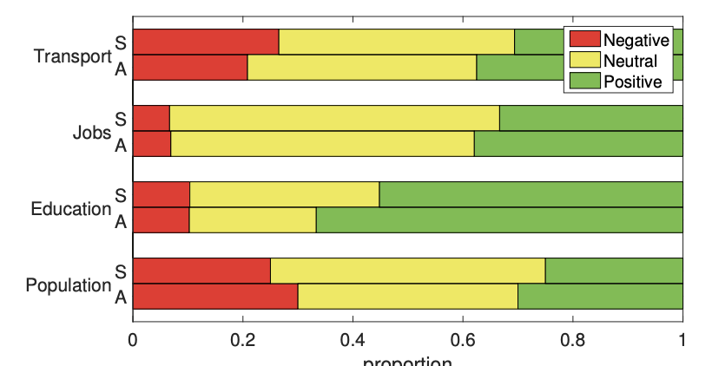
Silent users add information
Silent users opinions differ from talkative users

Slide 32
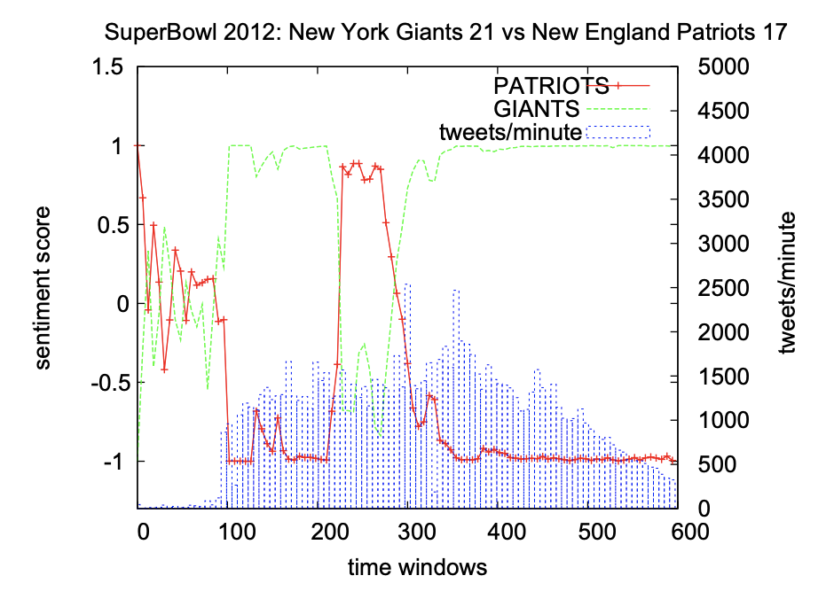
Misreports and Self-Selection
Users are more likely to report their extreme experiences.
Notes:
The New York Giants started the game scoring 2-0 at 158’
and 9-0 with a touchdown at 168’.
The Patriots scored two touchdowns in a row, at 224’ and
265’, reversing the expectations about the game outcome.
The Giants managed to score a touchdown in the last minute
of the game and were proclaimed the 2012 SuperBowl champions at 298’, generating a long period of happiness on their
supporters, whereas Patriots supporters were upset.

Slide 33
Content Production Biases
A type of behavioral bias
Users with different demographics write differently
Expressed as
lexical,
syntactic,
semantic,
and structural differences in content.

Slide 34
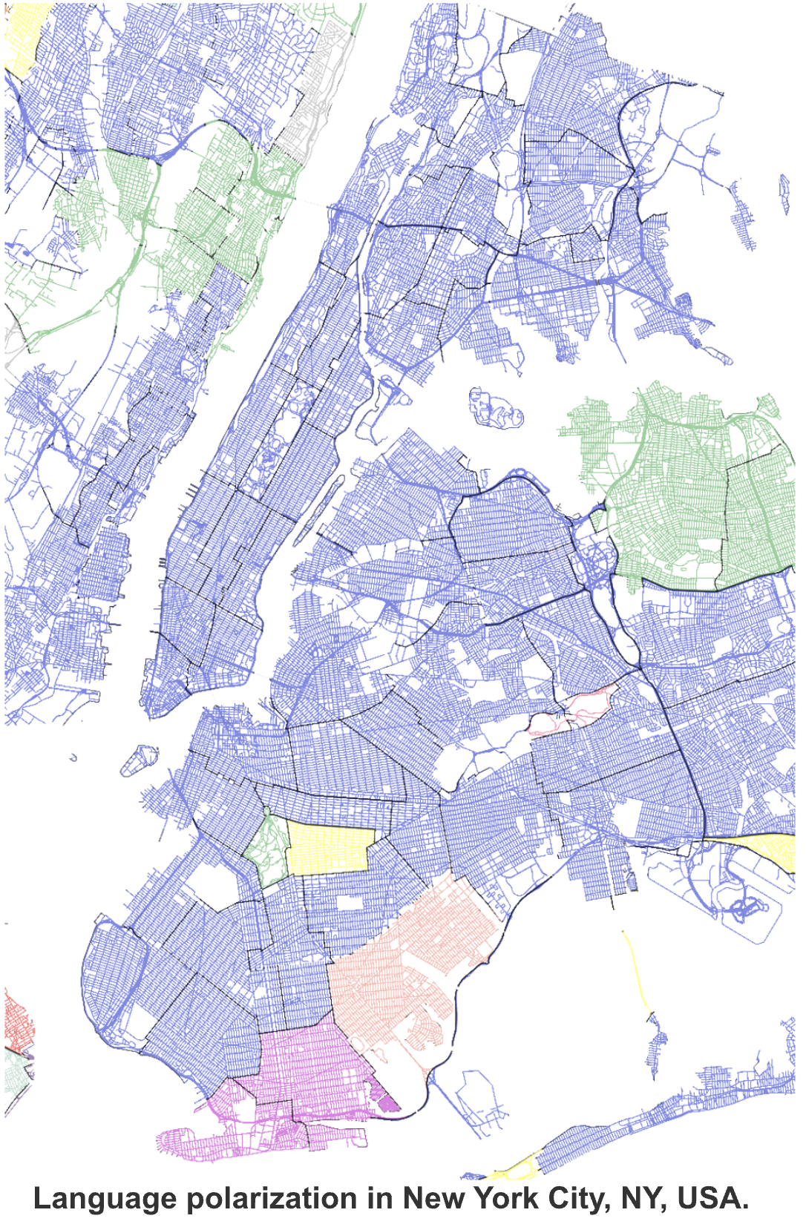
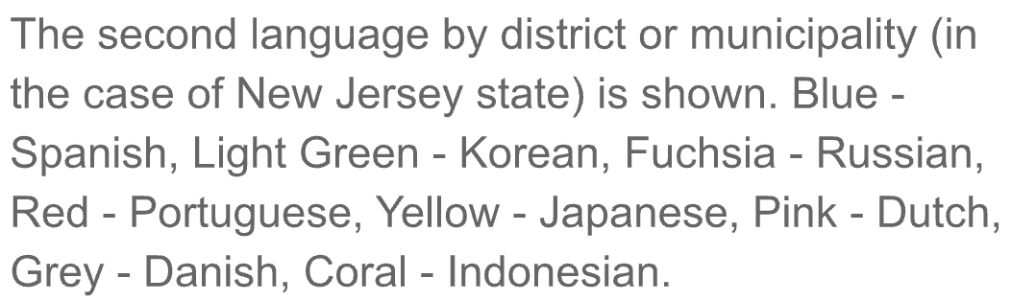
Language Use

Slide 35
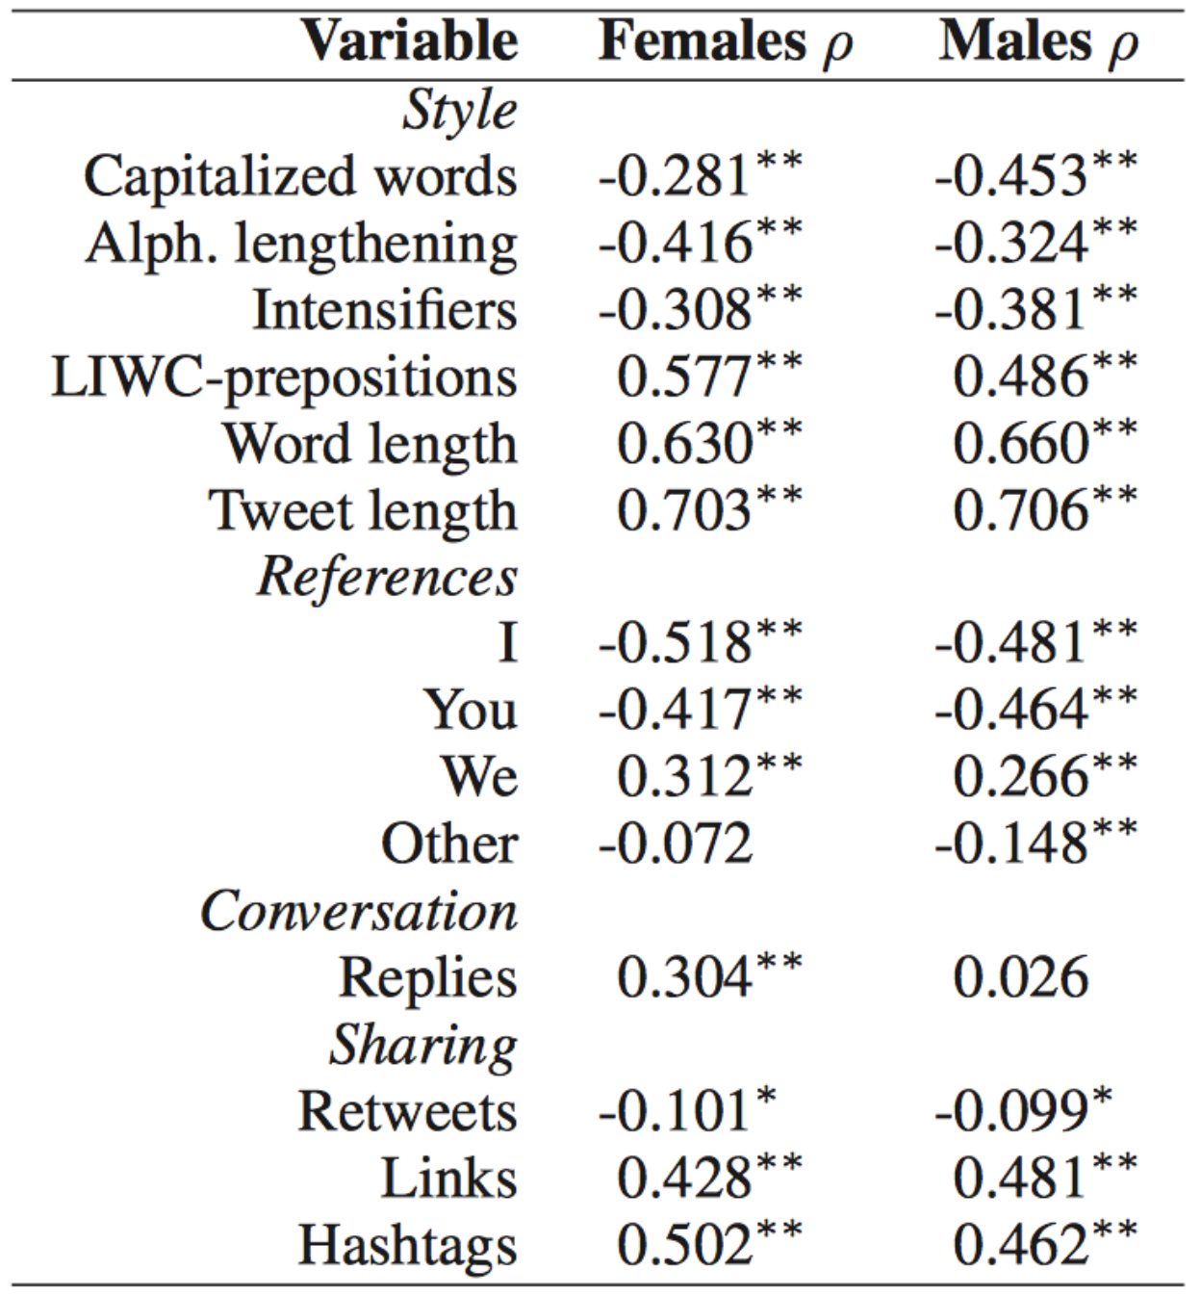
Use by Age and Gender
Use varies within and across populations

Slide 36

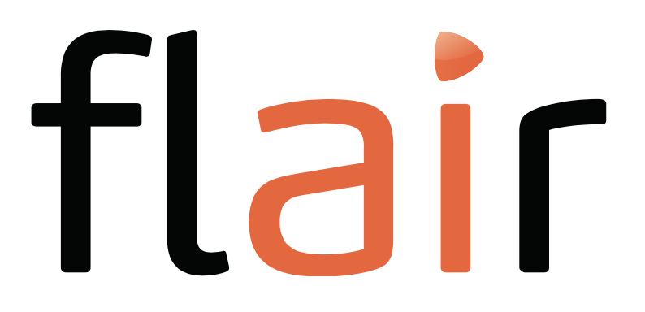

Broader Point: Text
Existing models are trained on real-world data.
This data is “social.”
Errors/biases in these models can reflect biases in society.

Slide 37
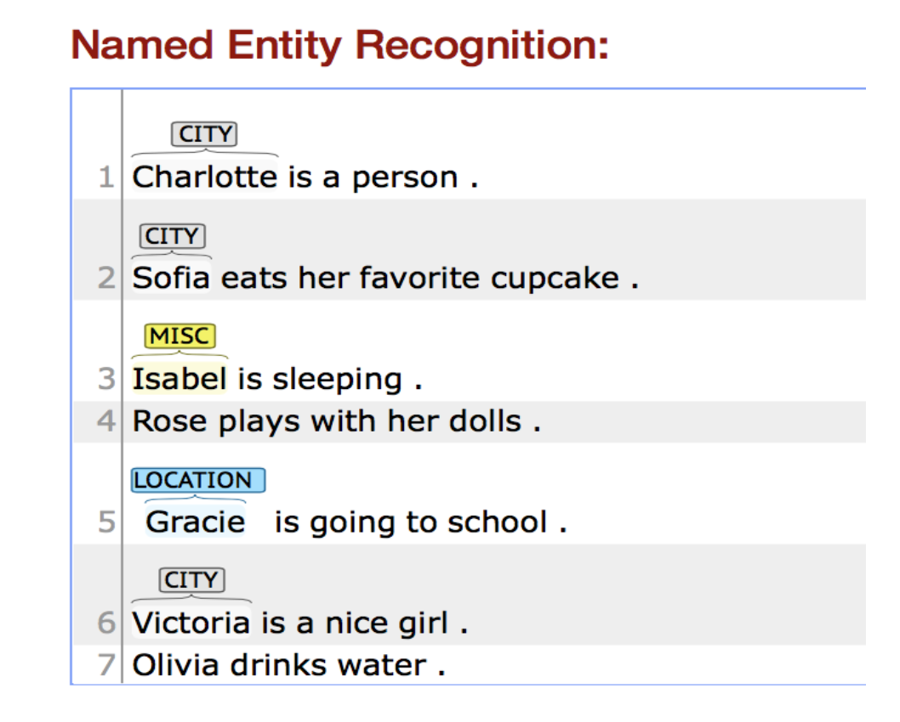
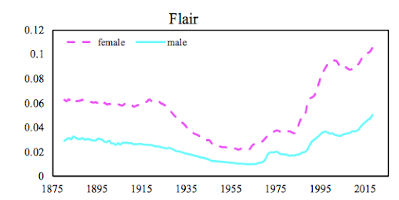
Bias in NER
Named Entity Recognition (NER) systems do not perform equivalently across names from different genders.
More female names are being mis-tagged or not tagged at all compared to male names.
Mehrabi, N., Gowda, T., Morstatter, F., Peng, N., & Galstyan, A. (2020, July). Man is to person as woman is to location: Measuring gender bias in named entity recognition. In Proceedings of the 31st ACM Conference on Hypertext and Social Media (pp. 231-232).

Slide 38
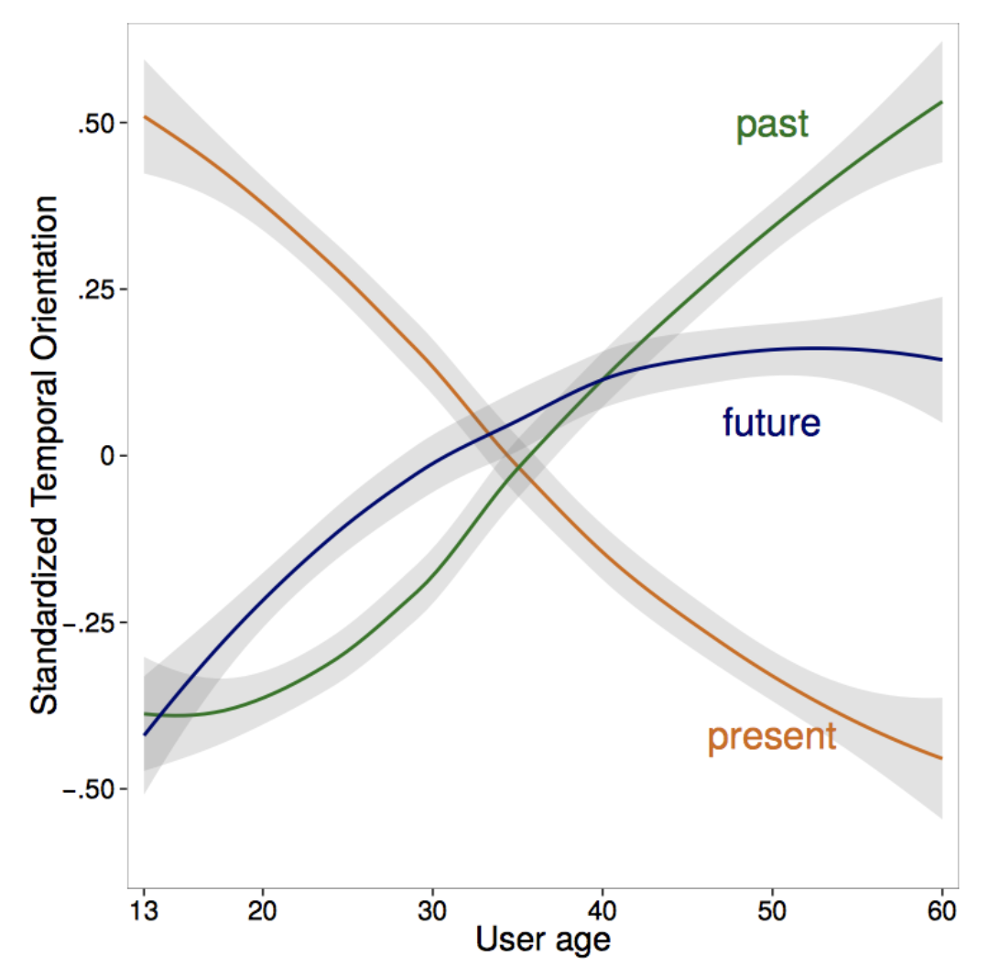
Contextual Factors
Young think about present
Old think about past/future

Slide 39
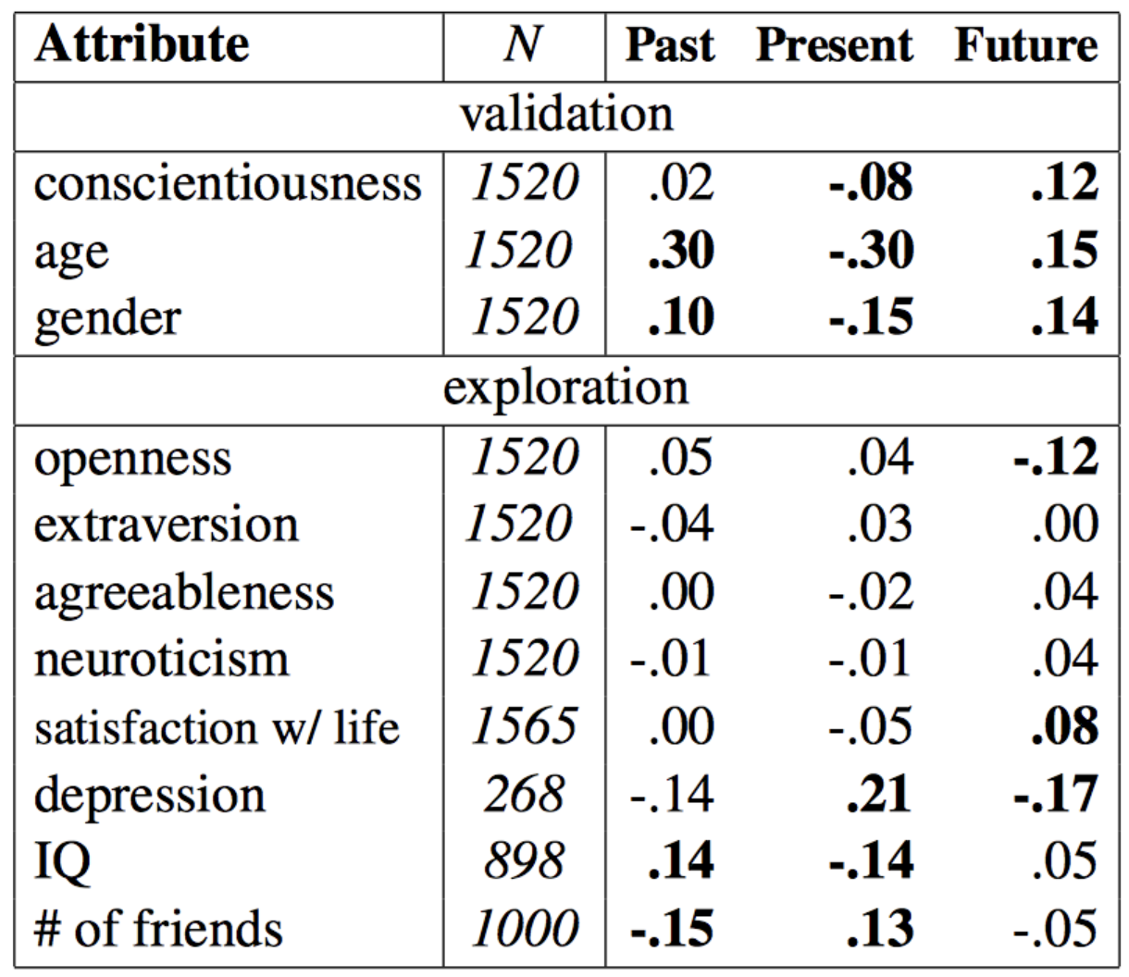
Contextual Factors
Correlations between user temporal orientation and human attributes
conscientiousness
age
gender
associated with temporal orientation
Notes:
Correlations between user temporal orientation and human attributes. The attributes conscientiousness, age, and gender are well-established in previous literature to be associated with temporal orientation

Slide 40
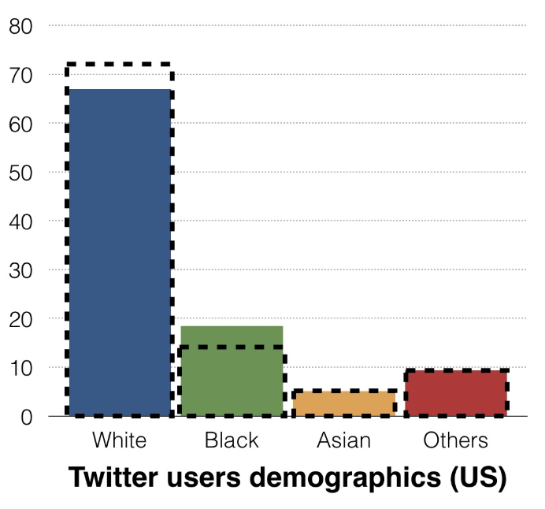

Different Populations, Different Topics
Notes:
Black dashed line -- US

Slide 41

Different Populations, Different Topics

Slide 42
Linking Biases
Behavioral biases expressed as differences in the attributes obtained from connections, interactions, or activity.
For example
who you talk to, who you follow, who you retweet can be different people
Reason for each interaction can be different (e.g., support versus argue)

Slide 43


Behavior and connection based links are different
Social graph (all friends)
interaction graph (who people talk to directly)
Social graph links > interaction graph
Especially who users interact with recently
Wilson, Christo, et al. "User interactions in social networks and their implications." Proceedings of the 4th ACM European conference on Computer systems. 2009.

Slide 44

Network attributes correlate with users’ behavior and perceptions

Slide 45

Online social network formation
Making connections depends on more than a network
The predictive power of the seven tie strength dimensions
Model predicts tie strength within one-tenth of its true value on a continuous 0–1 scale
Notes:
Depends on more than the network
The predictive power of the seven tie strength dimensions, presented here as part of the How strong? model. A dimension’s weight is computed by summing the absolute values of the coefficients belonging to it. The diagram also lists the top three predictive variables for each dimension. On average, the model predicts tie strength within one-tenth of its true value on a continuous 0–1 scale

Slide 46
Temporal Biases
Differences in populations and behaviors over time.

Slide 47

Populations, Behaviors, and Systems Change over Time

Slide 48

Seasonal phenomena Change Use
Notes:
From Foursquare

Slide 49

Time Granularity – Long-Term Phenomena

Slide 50

Datasets Decay over Time
2.3% - 3.6% deleted tweets (Arabic tweets, Oct. ‘14 - Dec. ’14)
5.7% of Boston Bombing tweets deleted (April ‘14)
Notes:
Messages explicity deleted by the user
User can switch their account to protected.
Account could be suspended.
Deactivate their entire account.

Slide 51

Dataset Decay

Slide 52
Redundancy
Same person, multiple accounts.
Same account, multiple people.
Multiple accounts, same content.
Semantic redundancy.

Slide 53
Functional Biases
Biases that are a result of the “environment”
Platform-Specific Mechanisms
User Behavior Conditioned therein

Slide 54

The way in which content is presented influences behavior

Slide 55


Platform Effects
Notes:
Facebook decreased the size of the reply window:
Users started to send shorter replies, faster, more frequently
Users’ expectations of speed became faster.

Slide 56
Normative Biases
Result of written norms or expectations about unwritten norms.

Slide 57

Norms vary across communities
Notes:
When a user evaluates user-generated content, they are evaluating other users.
Inverse halo effect: posts made after a negative evaluation were perceived worse than those made after a positive evaluation.

Slide 58

Users are Susceptible to Herding
Muchnik, Lev, Sinan Aral, and Sean J. Taylor. "Social influence bias: A randomized experiment." Science 341.6146 (2013): 647-651.
Notes:
up-treated given a +1

Slide 59

Online Hawthorne Effect
Notes:
Slacktivism

Slide 60

Other side of the coin: Privacy Concerns
Learn about people from, e.g., their Foursquare check-ins
Notes:
Data based on Foursquare checkins

Slide 61


Cultural Elements are Reflected in Social Datasets
Frequency of question posting
Question type, by category

Slide 62


Cultural Elements are Reflected in Social Datasets
Code Change Acceptance -- Github
Github code changes were accepted if people did not know the gender than when they did
(biased against women)
Notes:
Gendered – when Github could be linked to a SM account.

Slide 63
Issues from Data Collection
Source Selection Bias
Data Acquisition
Data Querying
Data Filtering
Notes:
Can come from collection OR preparation
Source selection encompasses everything so far, to a degree

Slide 64


Data Acquisition Bias
Some platforms offer no programmatic access (APIs).
Creates gaps between data and what users see.
LinkedIn TOS:

Slide 65

Data Acquisition Bias – Rate Limits
Notes:
Mention Academic API

Slide 66
Platforms Do Not Capture All Relevant Data
We know what people write, but not what they see.
Having access to this may reveal different insights.
What is exposure?
Public / private issue.

Slide 67
Platforms’ Sampling is Often Opaque
Twitter shares its data.
“Firehose” - 100% - costly.
“Sample API” - 1% - free.
Takes no parameters from users.
Returns a random 1% sample.
“Streaming API” - 1% - free.
Takes query parameters from user.
Returns tweets matching query.
Samples data when volume reaches 1%.

Slide 68


Dataset
500k from Streaming API
1.2M from Firehose
42% Overall Coverage
Daily Coverage from 17% to 89%.
17%
89%
Notes:
17% during the spike that we miss out on, 27th…
89% at the very beginning…
We will carry out the rest of the analysis with this data
Reza:
Show coverage

Slide 69

Top Hashtags
Streaming API
#syria
#homs
#damascus
#hama
#assad
#daraa
#mar15
#aleppo
#idlib
#sfp
Firehose
#syria
#revolution
#homs
#bashar
#egypt
#egitto3000
#kuwait
#bahrain
#damascus
#mar15
Top n Hashtags
Notes:
This is a plot of… HIGHER IS BETTER
settles with top 1000
but is misleading at the low numbers … WHEN WE INSPECT TOP HASHTAGS
What is the implication of negative correlation?
how do we know if this is significant?

Slide 70


APIs Have Limited Expressiveness
Often take just a few parameter types:
Twitter: keywords, geolocation, users.
Everything an OR?
Common Data Querying

Slide 71
APIs != Populations
User-selection criteria may include features held at lower rates by members of certain groups
E.g., unpopular keywords
Use of proxy populations that fail to correctly capture populations under study
Over or under-emphasis of certain types of users, such as active users or those perceived as relevant.

Slide 72
Choice of keywords is important!
Still far from perfect (misspellings)
Hashtags associated with certain political frameworks
Keyword based collections only capture a fraction of the relevant data.
1.4% of all tweets
#hrc
#imwithher
hillary
#strongertogether
Notes:
Still far from perfect (misspellings)
Hashtags associated with certain political frameworks
Keyword based collections only capture a fraction of the relevant data.

Slide 73

Keywords Overrepresent Media
Notes:
…at the cost of eyewitnesses

Slide 74

Data Cleaning Decisions Matter
Two different stoplists – two sets of results!

Slide 75

Data Representation Decisions Matter
How to represent missing values?
Do you interpret missing values as zeros?

Slide 76
What about Annotation?
Factors that affect quality:
Unreliable annotations
Poor annotation guidelines
Category design
Insufficient information
Ethical concerns – what can you show to the annotators?
Skewed difficulty of category assignment (babies vs people in their 40s)
Notes:
What about the annotators cultural background?

Slide 77
Ethical Boundaries to Research
Concepts and Principles
Individual Autonomy
Beneficence and Nonmaleficence
Justice

Slide 78

Concepts and Principles
Commissioned report in the US
3 principles:
Autonomy/Respect for persons: Respect for individual autonomy, protect diminished persons.
Beneficence and Nonmaleficence: maximize benefits; minimize harms.
Justice: benefits and the burdens should be divided justly.

Slide 79
Four Common Types of Research
 | Awareness | No Awareness
Manipulation | [Type I] User study, annotation | [Type III] A/B tests
No Manipulation | [Type II] User diaries | [Type IV] Observational studies

Slide 80

Individual Autonomy
Facebook Contagion Experiment
Paypal’s TOS text is 50k words
Shakespeare’s Hamlet is 30k

Slide 81

Beneficence and Nonmaleficence
Publicly available content wasn’t meant to be consumed by just anyone. [boyd and Crawford 2010]
Teens socializing in a public setting do not want to be public figures. [boyd and Marwick 2011]

Slide 82
Research outcomes can do harm
Aggregation: A person buys a book about cancer, and a wig.
Secondary use: “Mission/function” creep.
Collect embarrassing information: NSA studying web browsing patterns of target.
Distortion: Writer buys book on manufacturing meth to write a novel.

Slide 83

Justice
Other examples
Setting gender = female has been shown to give fewer higher-paying jobs on Google Ads.
Pricing of SAT tutoring 2x higher for people in predominantly-Asian ZIP codes.

Slide 84

Conclusion

